Slide 1


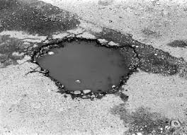
Title : Potholes Detection on roads using Deep Learning for Road Safety
Batch : W3
Team :
Karthik Yacharapu ( Team Lead)
Bhargav Chava
Pranay Nelapati
Kowsik Peddavarapu

Slide 2
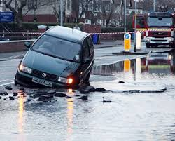
Why Potholes Are a Major Issue
Accident Risk: Potholes cause accidents, especially for two-wheelers.
Economic Loss: Increased maintenance costs for vehicles.
Public Safety: Delays and safety issues for emergency services.
Stats: Include 1-2 impactful statistics (like % increase in accidents caused by potholes).

Slide 3
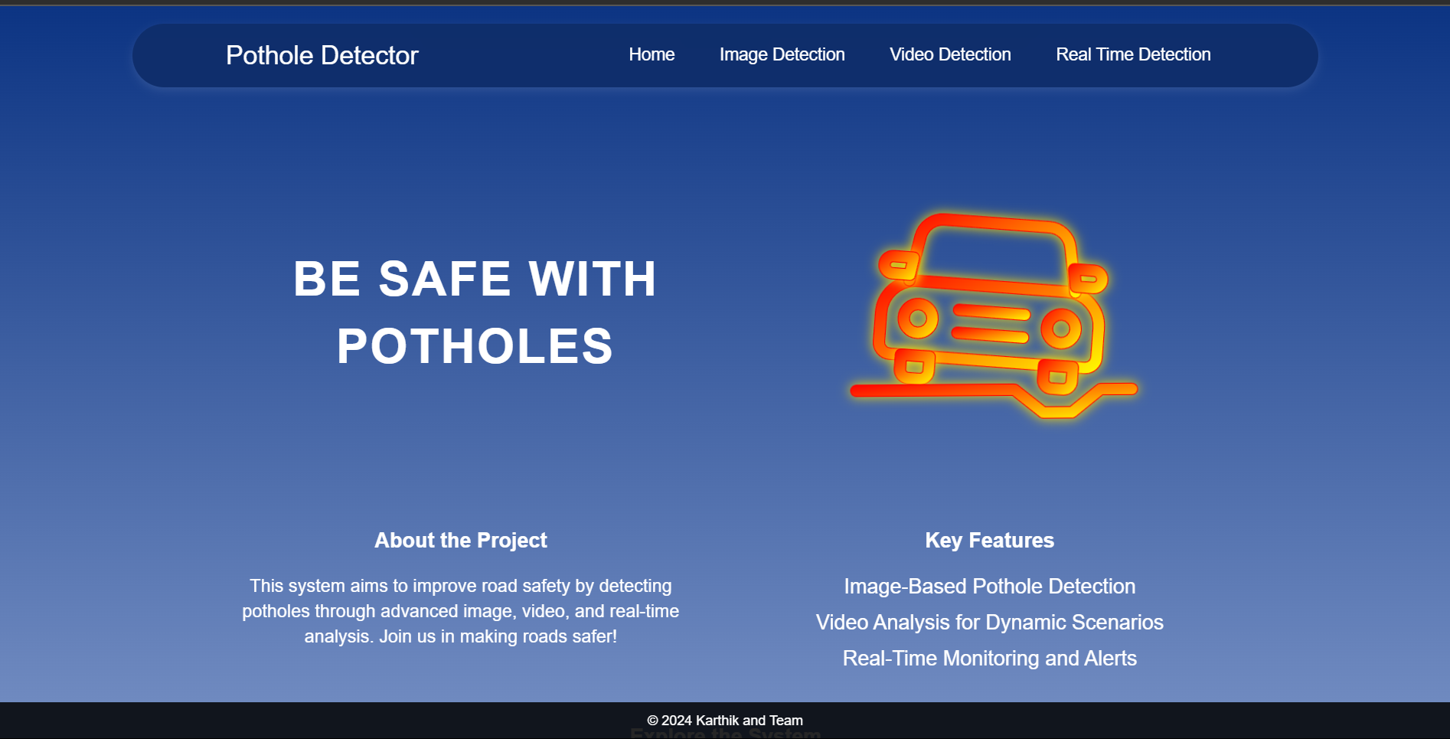
Our Solution: Automatically detects potholes on roads and highlights them in real-time

Slide 4
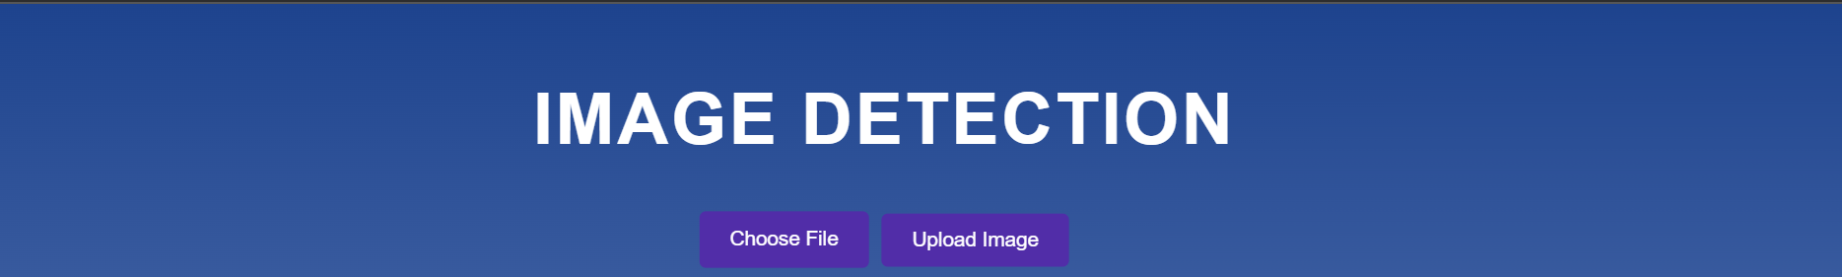
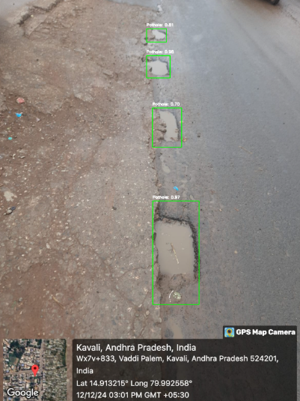
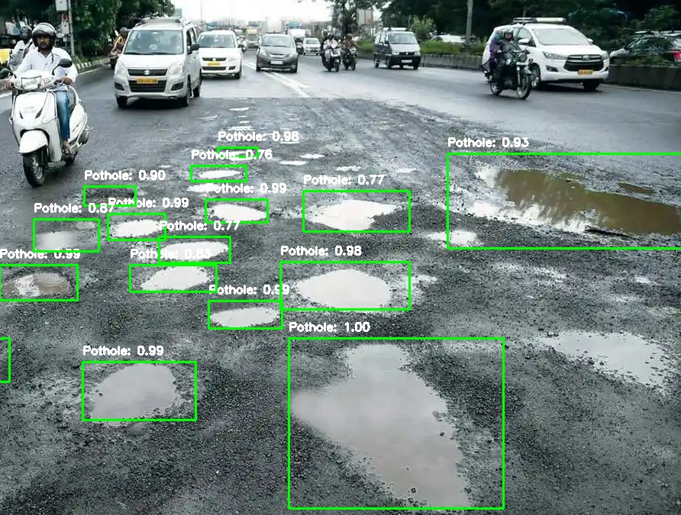
Image Detection

Slide 5

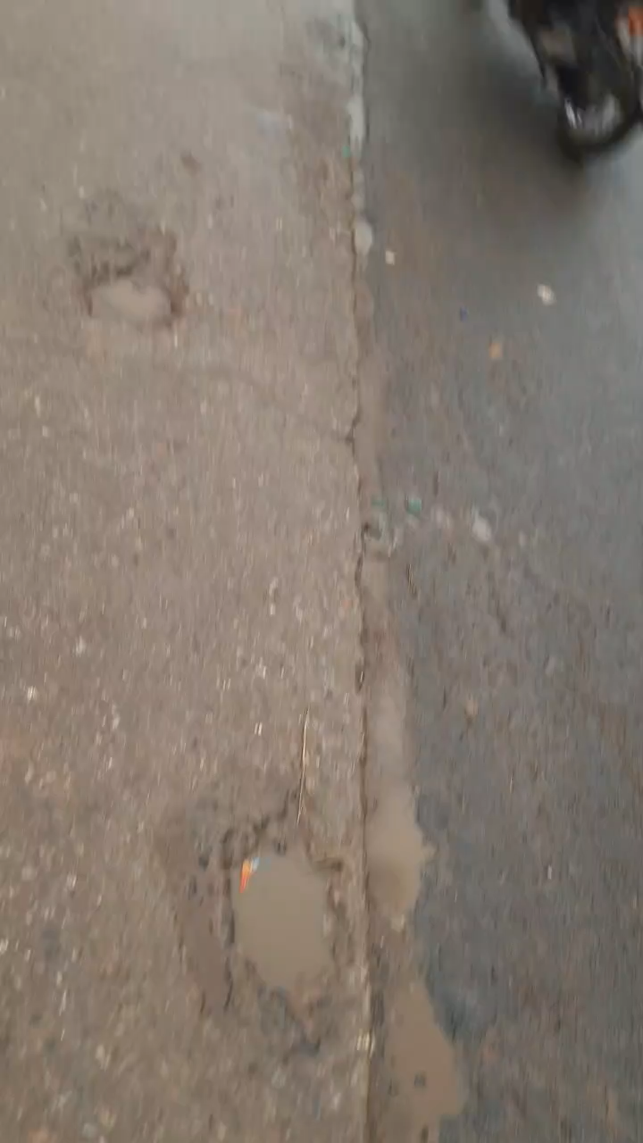
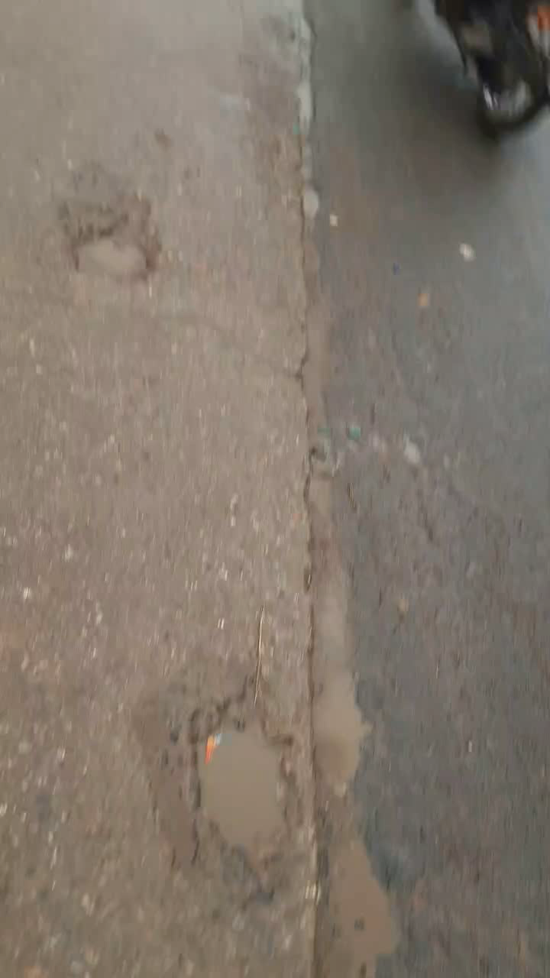
Before Detection After Detection

Slide 6
How It Works - Simple Yet Effective Process
Step 1: Data Collection – Road data is captured using cameras or smart devices.
Step 2: Detection – Potholes are automatically identified from the captured road data.
Step 3: Action – Reports are generated with the exact location and size of potholes.
Data Collection
Detection
Action

Slide 7

Impact & Benefits
For the Public: Safer, smoother roads reduce accidents and improve commute times.
For the Government: Saves road repair costs and enables faster response to potholes.
For the Environment: Fewer emergency repairs reduce CO2 emissions.

Slide 8
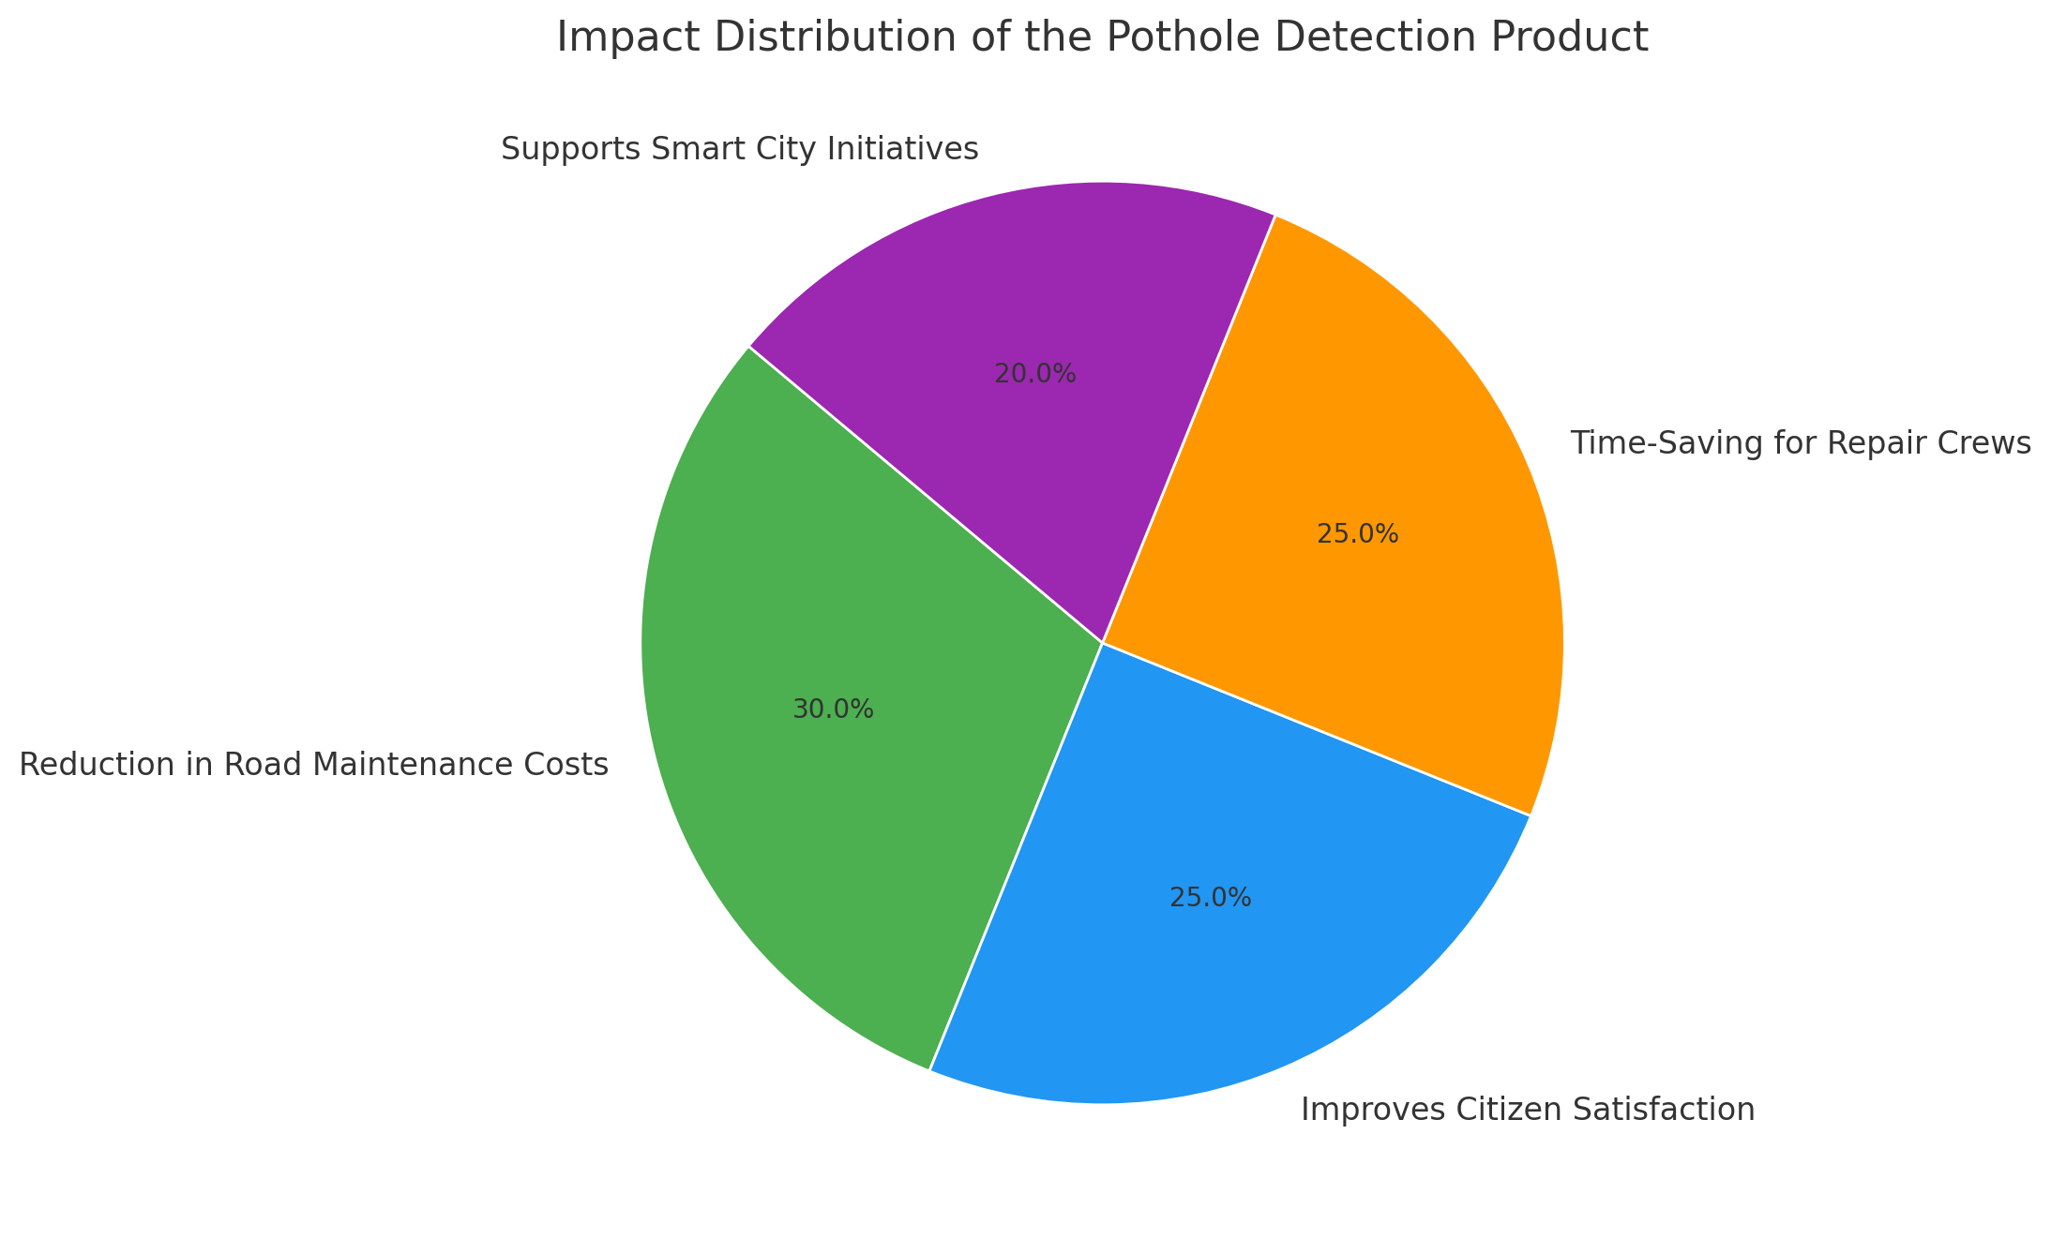
Why This Product Deserves Support
Reduction in Road Maintenance Costs –
Improves Citizen Satisfaction
Time-Saving for Repair Crews
Supports Smart City Initiatives

Slide 9

Resources
Check here with this link: https://drive.google.com/drive/folders/1el9JhsdZrjT2ZpwKz3TuSEsFtM6mZq9x?usp=sharing
Or
Scan this Qr:

Slide 10
Thank you

